Slide 1

RAGHU ENGINEERING COLLEGE
(AUTONOMOUS)
DEPARTMENT OF EEE
Academic year: 2018-2019
II year 2-semister
Electrical Machines-1
CASE STUDY
ON
SLIP TEST ON SALIENT POLE 3 PHASE ALTERNATOR
FACULTY:
Mr.S.Kranthi kumar
Associate professor
BATCH-3
18985A0246 – K.Karthik
18985A0247 – L.Ratnakara Rao
18985A0248 – M.Gaddim Naidu
18985A0249 – M.Jagapathi varma
18985A0250 – M.Sai

Slide 2
What is slip?
slip can be defined as the difference between the flux speed (N_{s} ) and the rotor speed (N_{r}). Speed of the rotor of an induction motor is always less than its synchronous speed. It is usually expressed as percentage of synchronous speed(N_{s}) and represented by the symbol ‘S’.
Slip S= N_{s}-N_{r} * 100
N_{r}

Slide 3
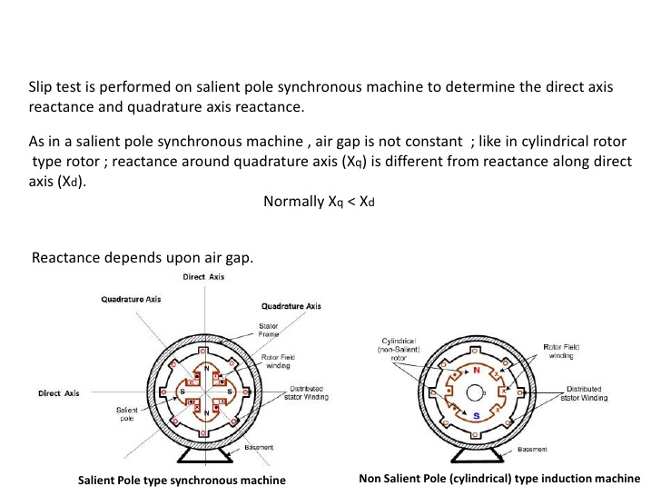

Slide 4
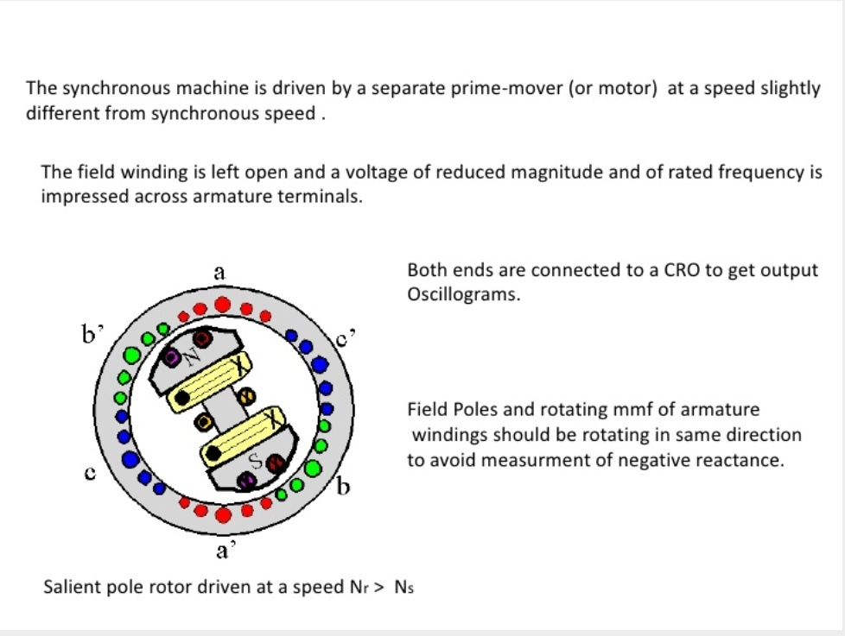

Slide 5
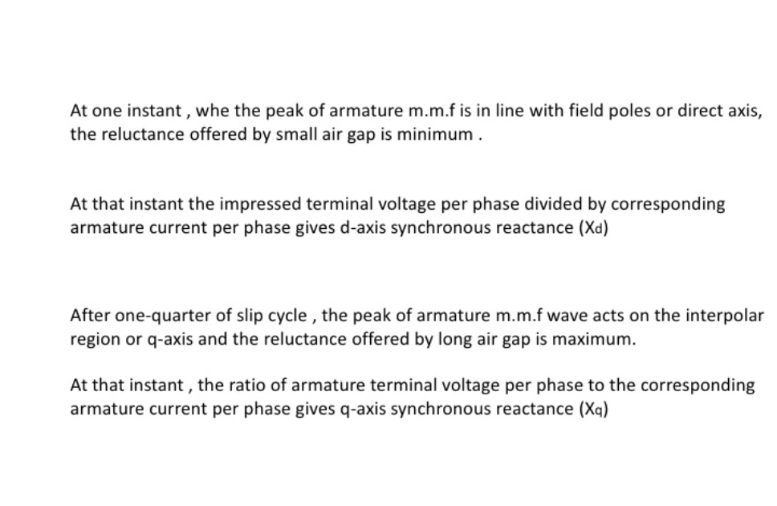

Slide 6
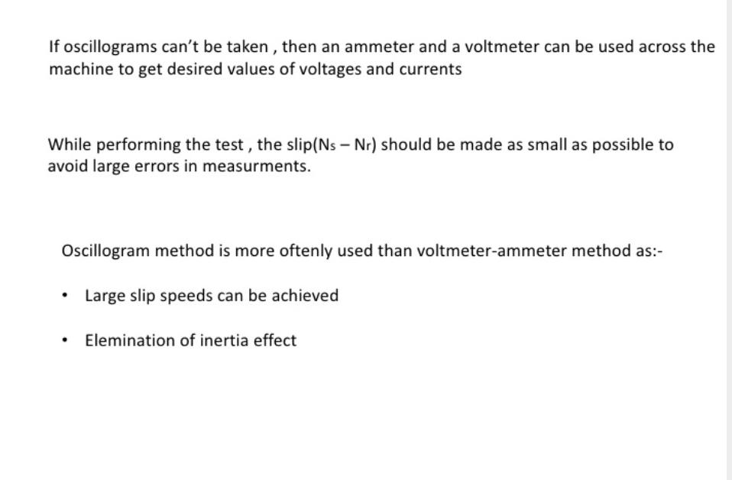

Slide 7
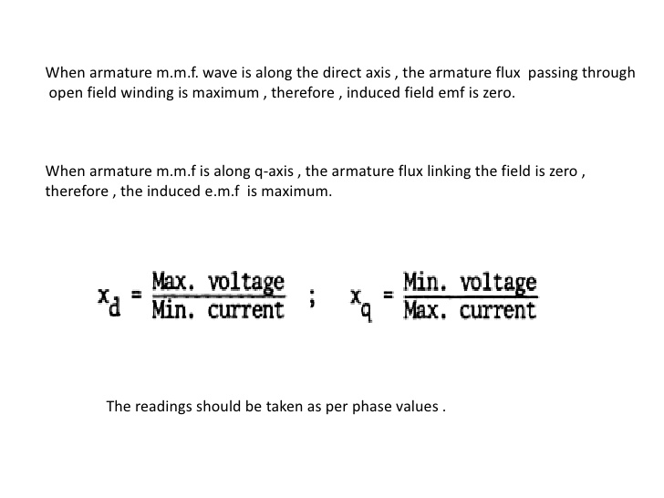

Slide 8
SLIP TEST ON SALIENT POLE ALTERNATOR
AIM:-
To determine X_{d} and X_{q} by conducting slip test.
To pre-determine the regulation at upf different powerfactor and load
To plot power Vs load angle graph
APPARATUS REQUIRED:-
S.No | Name of apparatus | Range | Type | Qty.
1. | Ammeter | (0-10)A | MI | 1
 |  | (0-5)A | MC
2. | Voltmeter | (0-500)V, | MI | 1
 |  | (0-150)V
3. | Voltmeter | (0-30)V | MC | 2
4. | Rheostat | 1200 Ω, 0.8A |  | 1
 |  | 45 Ω, 5A
5. | Tachometer | - | Digital | 1

Slide 9
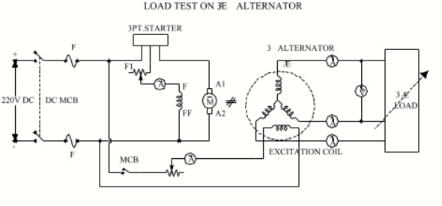
Circuit diagram:-

Slide 10
Theory:-
If a synchronous machine runs at a slightly less than the synchronous speed, the field structure is exposed to the rotating mmf of armature reaction. Hence the poles and armature reaction mmf fall in phase and out of phase at slip frequency. Where the axis of two coincides, the armature acts through the field magnetic circuit, including maximum voltage in the field. The direct axis reactance X_{d} (and hence the impedance Z_{d}) is maximum resulting in the armature current being minimum. Where the field poles are in quadrature with armature mmf, quadrature axis reactance X_{q} (and hence the impedance Z_{q}) will be minimum resulting in the armature current maximum. Hence,
Z_{d} = Max. voltage / min. current
Z_{q} = Min. voltage / max. current

Slide 11
PROCEDURE:-
Make connections as shown in circuit diagram.
Start the set and bring it to near synchronous speed keeping the field of the alternator open.
Apply an AC voltage of reduced magnitude (about 25% of the rated value). The field poles and armature mmf should rotate in same direction this can be verified by measuring the voltage across the field winding (It should be nearly equal to zero) Otherwise interchange the stator terminals.
Adjust the speed of the alternator to get sufficient oscillations (Maximum deflection) in the meter.
Note down the maximum and minimum value of ammeter and voltmeter.

Slide 12
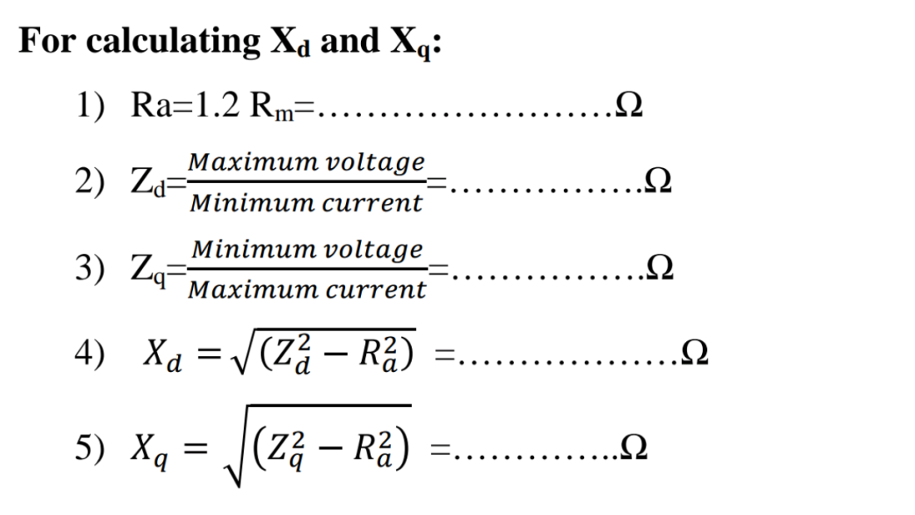
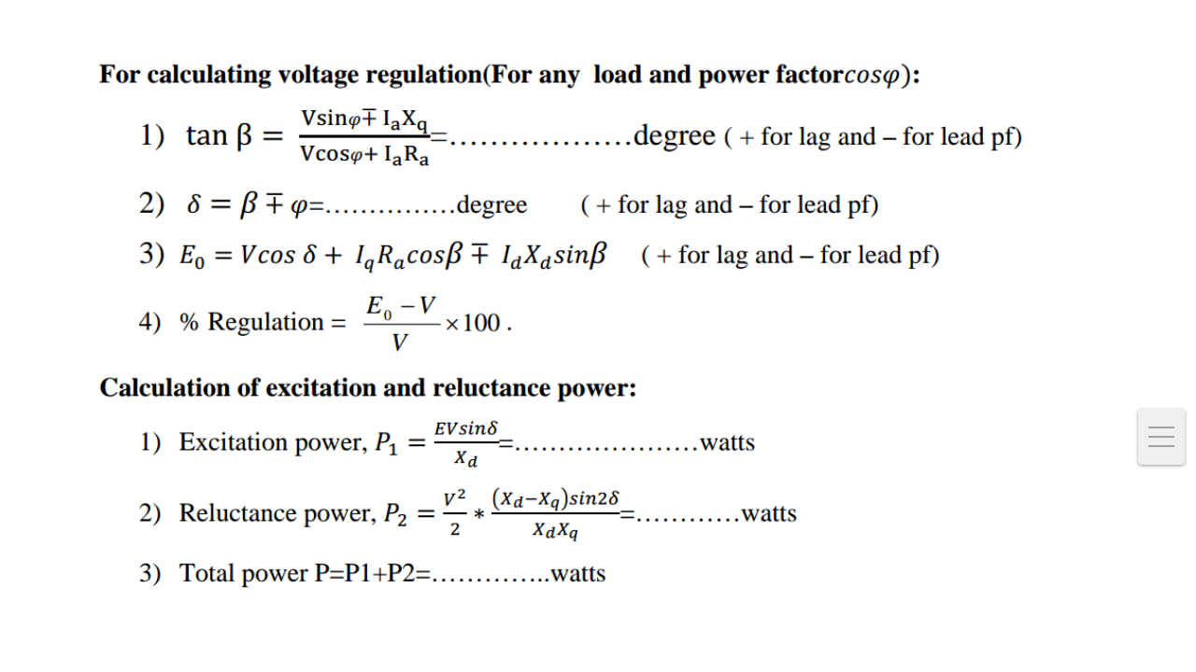
4.5
2.5
1.564
1271.85K
1750.5K
3022k

Slide 13
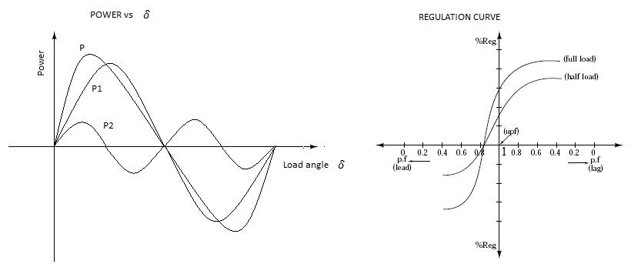
MODEL GRAPHS:-

Slide 14
RESULT:-
Performed slip test, calculated d axis and q axis synchronous reactance and plotted the graphs

Slide 15
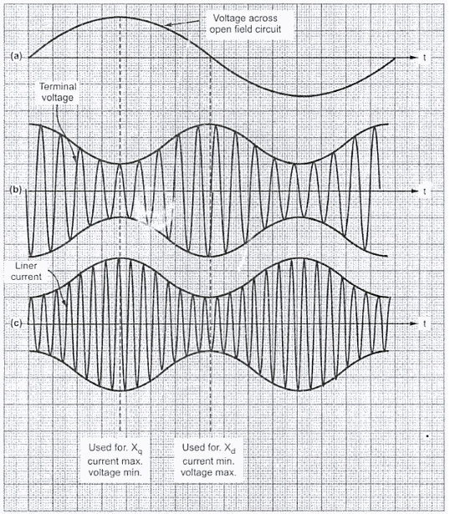


Slide 16
Example :-
A salient pole synchronous machine with 4 poles AC windings is coupled to a prime mover. The machine is running at a speed of 1490 rpm. The synchronous machine stator is excited with a current of 50 Hz frequency the rotor winding of the machine is open. Per phase voltage and current for phase A of the machine of 30v, 25v, 10A and 6.5A. Armature resistance is negligible. The name plate ratings of the machine is 20MVA, three phase star connected,11 KV, 50Hz. At full unity Pf and rated voltage. Calculate
(a) the excitation voltage and ,
(b) the reluctance power de3veloped by the machine.

Slide 17
Programme:
Clc
x = [ 0.1:0.1:1]
theeta = [0:10:80]
powerfactor = cosd(theeta)
t = sind(theeta)
loadangle = t
p = 4
poles = p
n = 1490
speed = n
f = 50
frequency = f
vmax = 30
perphasevoltagereading1 = vmax
vmin = 25
perphasevoltagereading2 = vmin
imax = 10
perphasecurrentreading1 = imax
imin = 6.5
perphasecurrentreaeding = imin
s = 20000000
machinerating = s
v = 11000
voltage = v
x = 1
powerfactor = x

Slide 18
ns = 120*f/p
synchronousspeed = ns
xd = vmax/imin
xq = vmin/imax
ia = s/(sqrt(3)*v)
fullloadarmaturecurrent = ia
vt = v/sqrt(3)
perphasearmaturevoltage = vt
ef = sqrt((vt)^2+((ia*xq)^2))
d = atand(ia*xq/vt)
loadangle = d
id = ia*sind(d)
ef2 = vt*cosd(d)+id*xd
vl = sqrt(3)*ef2
linevalueofecitationvoltage = vl
sind2d = 2*sind(d)*cosd(d)
xr = ((vt)^2/2)*((xd-xq)/(xd*xq))*sind2d
reluctancepowerdevelopedbymachine = xr
totalreluctancepower = 3*xr/1000
p1 = ef*v*sind(d)/xd
excitationpower = p1
p2 = ((vt)^2/2)*((xd-xq)*sind2d)/(xd*xq)
reluctancepower = p2
p = p1+p2
totalpower = p
grid on
plot(loadangle,excitationpower,'k*:',loadangle,reluctancepower,'m*:',loadangle,totalpower,'k*:')

Slide 19
COMMAND RESULT:-
poles =4
speed =1490
frequency = 50
perphasevoltagereading1 = 30
perphasevoltagereading2 =25
perphasecurrentreading1 =10
perphasecurrentreaeding = 6.5000
s =20000000
Machinerating= 20000000
v = 11000
voltage =11000
x = 1
powerfactor = 1
ns =1500
synchronousspeed = 1500
xd = 4.6154
xq = 2.5000
ia = 1.0497e+03
fullloadarmaturecurrent = 1.0497e+03
vt = 6.3509e+03
perphasearmaturevoltage = 6.3509e+03
ef = 6.8717e+03
d =22.4515
loadangle =22.4515
id = 400.8931
ef2 =7.7198e+03
vl =1.3371e+04
linevalueofecitationvoltage =1.3371e+04
sind2d =0.7059
xr = 2.6099e+06
reluctancepowerdevelopedbymachine = 2.6099e+06
totalreluctancepower = 7.8297e+03
p1 =6.2546e+06
excitationpower = 6.2546e+06
p2 = 2.6099e+06
reluctancepower = 2.6099e+06
p = 8.8645e+06
totalpower = 8.8645e+06
>>

Slide 20
Thank you

